Slide 1
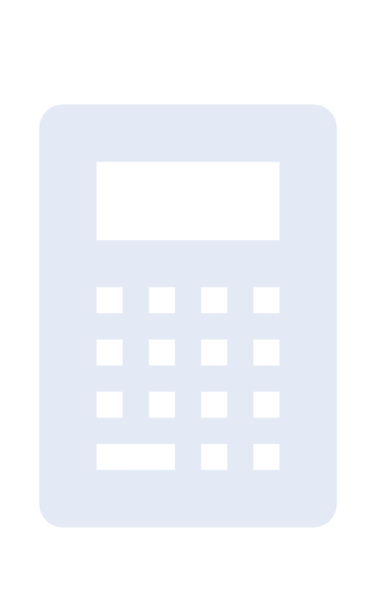
Project Title: Python Based GUI Calculator
Made By: GARIMA MAHAJAN
Institute: Digicrome

Slide 2
Project Overview
Python calculator(GUI application) constructed using Tkinter library in VS Code
Clickable buttons that performs core mathematical operations encompassing addition, subtraction, multiplication, and division
Allows the seamless execution of mathematical calculations
Yielding results coupled with the ability to clear the equation display

Slide 3
Problem Statement
Basic Python Calculator creation was known
To inculcate that knowledge for creating a Graphical User Interface CALCULATOR FOR ENHANCED VISUALISATION

Slide 4
Solution
To build Python Based GUI Calculator:
- Tkinter library was used to create the GUI interface
- Basic functions were employed

Slide 5
Methodology
Tkinter library was used using import Tkinter as tk.
VS Code used for the Python code
def keyword was used to define 3 functions:
- add_to_calculation
- evaluate_calculation
- clear_field
Global keyword was used in the functions to create global variable inside the function.
root= tk.Tk() for creating a GUI window
root.title to give title to GUI application
root.mainloop() is method to execute in the window

Slide 6
Methodology
try and except keywords were employed inside evaluate_calculation to avoid any errors
Individual buttons were created as tk.Button as part of the root window
Grid method was used to put button(widgets) in table format(rows,columns)
Lambda function was used to have the particular expression evaluated only when called

Slide 7
Methodology
For each button, position was specified using row and column number
Paranthesis was removed in clear_field function button because the function is being passed and not called
Lambda is removed in clear and equals button since there is no parameter for the function in that case

Slide 8
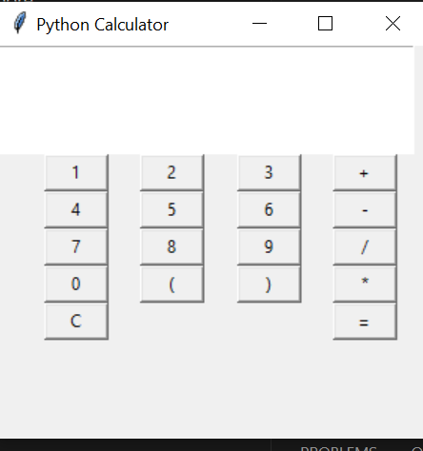
Key Features
The image displays the final appearance of the GUI Calculator

Slide 9
Results and Achievements
Tkinter library use for the creation of GUI interface
Core Python
Visual Studio Code(VS Code) for Python code
Application development using python code

Slide 10

THANK YOU!

